Slide 1
Electricity Infrastructure: More border crossings or a borderless Europe
Georg Zachmann

Slide 2
Agenda
The current context: many complicating factors
Insufficiency of the current approach
Proposal
Discussion

Slide 3
The 'system nature' of the electricity sector
Individual decisions have an impact on all other actors
Very different solutions for the same problem
chicken-and-egg problems

Slide 4
Uncertainty
Volatile regulatory environment
In the past two decades:
liberalisation, unbundling, cross-border trading
renewables support,
emissions trading,
nuclear phase-out
And in the future
European integration
Electrification vs. energy efficiency
…
vs. long asset lifetimes

Slide 5
Different interests: stakeholders
Everybody wants a different transmission network:
Consumer (connect to low and stable prices)
Producer (connect to high prices)
Storage (connect to volatile prices)
TSOs (domestic copperplate – controllable international)
Regulators (domestic benefit)
Residents (NIMBY)

Slide 6
Different interest: countries
Exporting countries
Transit countries
Importing countries

Slide 7
Complex funding structures
'regulated asset base'
International spillovers require cost-benefit analysis and corresponding redistribution scheme
Not yet present
=> Academically challenging and politically complex
Merchant lines
Public money

Slide 8
Agenda
The current context: many complicating factors
Insufficiency of the current approach
Proposal
Discussion

Slide 9
Insufficiencies of Market rules
Congestion within countries will be dealt with differently from network congestion between countries
Network codes are unlikely to bring about workable interfaces at all borders for all dimensions of electricity trade
National markets/regulations will remain pivotal for investment

Slide 10
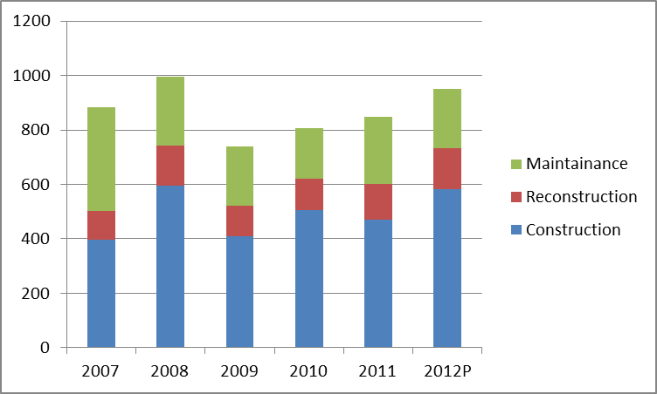
Building the network
Transmission investment in Germany in Mio €
Planning
a non-binding proposal by ENTSO-E to the individual TSOs.
stakeholder not legally accountable
non-transparent
Funding
Merchant: underbuilds
CEF: only ~5 bn and politically selected projects
RAB: lack of int’l CBA
Source: Bundesnetzagetur (2012)
2012 status of 2010 TYNDP projects

Slide 11
Proposal
The current context: many complicating factors
Insufficiency of the current approach
Proposal
Discussion

Slide 12

Add a European system management layer
European control centre (See flight control )
Internalise redistribution
Nodal pricing
Day-to-day responsibility with national fall-back

Slide 13
Establish a stringent planning process
Upgrade the TYNDP: national regulators can only approve projects proposed by European planning
Make the TYNDP welfare-maximising: ACER should be requested and enabled to thoroughly check that the TYNDP maximises the welfare of current and future European citizens.
Build an European open-source reference energy infrastructure model
Structure a process in which all relevant stakeholders can contribute to the assumptions and the modelling
Make stakeholders liable to claims for damages from other stakeholders if they deviate from their predictions
Democratically legitimise the TYNDP : to reach conclusion on distributional consequences

Slide 14
Phase in European cost-benefit sharing
Deep connection charges
Harmonized grid tariff structure (distribution between network users)
An approximate beneficiary pays component
A socialization component

Slide 15
Conclusion
The current context: many complicating factors
Insufficiency of the current approach
Proposal
Discussion

Slide 16
Cooperation on a line-by-line basis vs. institutionalized cooperation ?
Pro institutionalization:
Efficiency gain of a European picture
Consistent target market design reduces uncertainty
Infrastructure planning as an anchor for coordination
Avoid triggering down of national infrastructure plans on the power system
Contra institutionalization :
Is a stable consensus feasible?
Transaction cost of institutionalization?

