Slide 1

Non price criteria in renewable energy auctions and consequences for the European solar PV industry
Fifth International Conference - 16-17 April
Environmental Economics: A Focus on Natural Resources
Thibault Deletombe – DIW Berlin / CEA I-TESE

Slide 2
Non price criteria in renewable energy auctions and consequences for the European solar PV industry
Introduction
Analytical framework
Case study
Conclusion

Slide 3
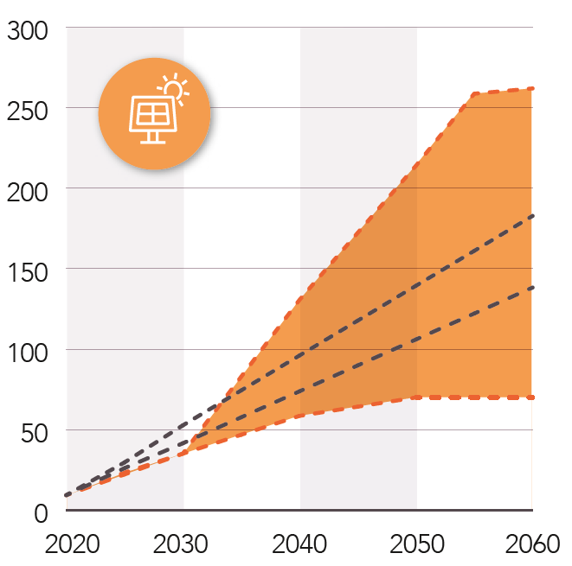
Context – Scenarios for solar photovoltaic (PV) development
EU solar photovoltaic (PV) capacity in 2024: 338 GW (IRENA, 2025)
EU 2030 target for solar PV: 600 GW (European Commission, 2022)
Installed solar PV capacity (GW)
Scenarios of photovoltaic capacity development in France (source: RTE, 2021)

Slide 4
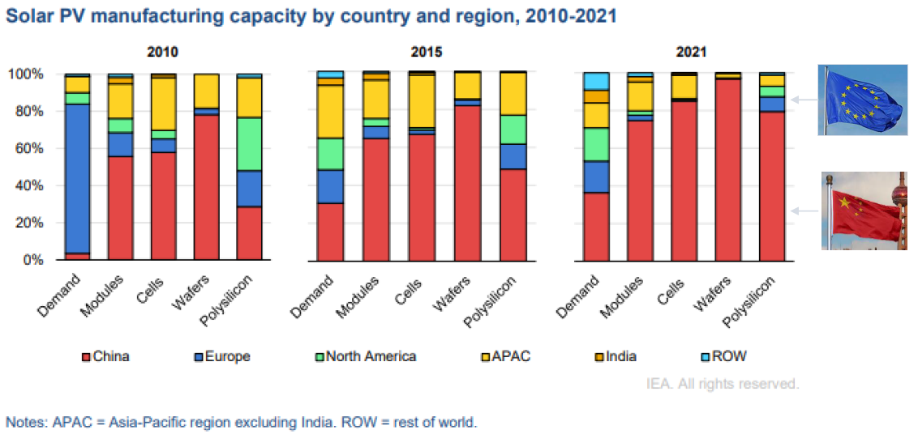
Context – A concentrated global supply chain
Solar PV manufacturing capacity by country and region, 2010 - 2021(source: IEA, 2022)

Slide 5
Context – The Net Zero Industry Act and the European solar PV strategy
The Net Zero Industry Act declares solar PV a strategic technology and sets ambitious goals for the development of the European solar PV manufacturing sector.
In particular, in 2030, the Net Zero Industry Act target:
    To supply 40% of the European demand for solar panels with European products
    To develop 30 GW of manufacturing capacity in the EU across the solar PV supply chain

Slide 6
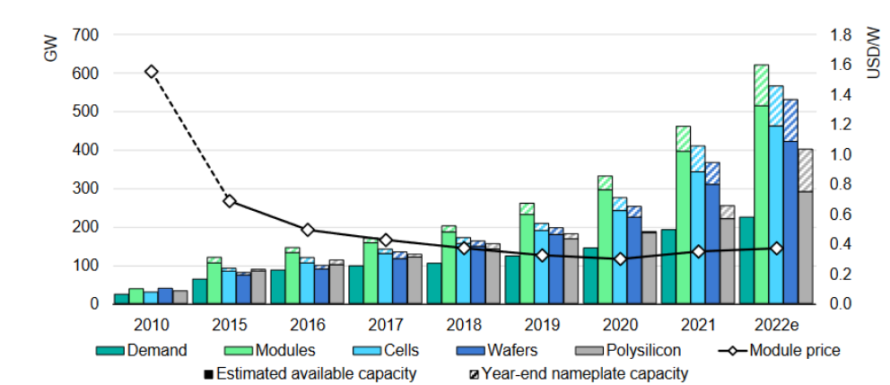
Context – A sector with significant overcapacities
Global PV manufacturing capacity, demand and average module selling price, 2010 – 2022 (source: IEA, 2022)

Slide 7
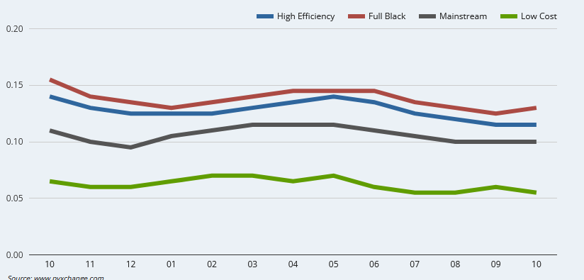
Context – Prices are below production costs
Production costs of EU producers : 0,25 – 0,3 €/W (ETIP PV, 2024)
€/W
CAPEX support measures are likely insufficient to reach European manufacturing targets
Demand support measures for European products are necessary to achieve the NZIA ambition
October 2024
October 2025
Solar PV price in Europe (source: pvxchange.com, 2025)

Slide 8
Context – Demand support measures: Non-price criteria and Made-in-Europe criteria
Policy instrument proposed by the Net Zero Industry Act
The NZIA introduce non-price criteria in the design of solar PV support scheme
System integration Innovation Environmental Resilience | Time, space, energy carriers Efficiency, raw material, longevity, circularity, etc. Carbon, energy efficiency, circularity, etc. Bonus for supply outside of dominant source
Policy instrument proposed by the Industrial Accelerator Act
Introduce Made-In-Europe criteria to create demand for European manufacturing

Slide 9
Motivation – First implementation of Non-price criteria are heterogeneous
First implementations of non-price criteria in solar PV support schemes are heterogeneous
  France rewards reduced carbon footprint and environmental pollution (CRE, 2025; Journal Officiel de la République Française, 2025)
  Italy rewards increased solar panel efficiency (MASE, 2025)
  Spain frames resilience as an award criterion and not a pre-qualification criterion (Boletín Oficial del Estado, 2025)
Market fragmentation risk
  Europe must innovate and produce at scale to close the gap with international competition
  Market fragmentation reduces competition and market size, ultimately innovation and economies of scale
  There is a tension between the NZIA objectives and instruments to achieve them
How to design non price criteria that foster European manufacturing investments while balancing decarbonization, resiliency, and competitiveness?

Slide 10
Literature review
This paper relates to multiple strands of literature
Renewable auctions: Bichler et al. (2020), Kröger et al. (2022), Thomaßen and Fuhrmanek (2025)
Green public procurement: Krieger and Zipperer (2022), Liu et al. (2025), Chiappinelli et al. (2025)
Local content criteria: del Rio and Kiefer (2023), Münch and Scheifele (2023), Anatolitis et al. (2025)
Economic geography: Smith and Venables (1988), Venables (1990), Dluhosch (2006), Larue (2018)
Competition and economies of scale: Amir (2000), Amir and Lazzati (2011), Gama (2019)

Slide 11
Market fragmentation: Efficiency losses and fairness in European solar modules manufacturing
Introduction
Analytical framework
Case study
Conclusion

Slide 12


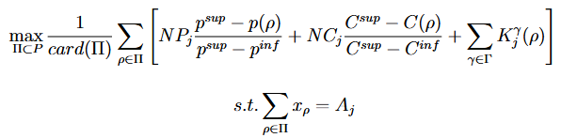
Analytical framework – Solar PV auctions and projects selection
French renewable procurement design (CRE, 2025)
  Fixed volume of tenders: 1 GW of solar PV per period
Scoring Criteria |  | Value
Price |  | NP0 = 70
Carbon |  | NC0 = 16
Other | Environmental impact (E) Governance (G) Funding (F) | E + G + F = 14
Winning bids are a solution to the following problem
Price
Carbon
Project’s average score
Other
Average score maximization
Volume constraint

Slide 13
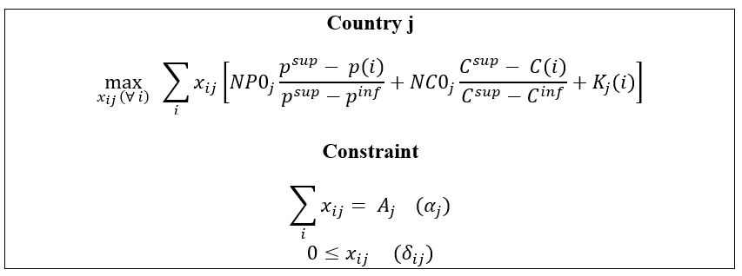
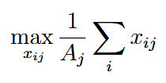

Analytical framework – Solar module demand: Price, carbon and national preferences
Solar module (i)
Average (W)
Price (€/W)
Carbon footprint (tCO2/W)
Average score maximization
Solar module (i)
Price score
Carbon score
Non-price criteria score
Volume constraint
Positivity constraints
Linear economies of scale

Slide 14
Analytical framework – Solution and Nash equilibrium
The price criterion (NCP > 0, NC0 = 0 and K = 0)
Project developers all sourced from the same supplier to benefit from economies of scale
  Cost-efficiency is maximal
  Only one firm i with non-zero production at equilibrium
  Competition intensity in the market is minimal
Price and non-price criteria (NCP < NC0 + K)
Non-price criteria dominate the price criterion
  Possibly multiple firms with non-zero production depending on non-price criteria heterogeneity
  The same product cannot compete in two different auctions: the market is fully segmented
  Cost efficiency is weakened
Can we accommodate cost efficiency and competition?

Slide 15

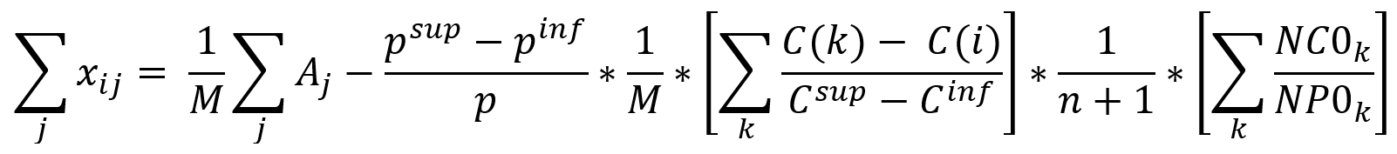
Analytical framework – Necessary conditions for competition
Necessary conditions for M firms with non-zero production to compete in the market
“The dual variables of the positivity constraint must be zero”
First order conditions
Tech. i production
Without non-price criteria (NC0 = 0 and K = 0), enforcing competition yields a new equilibrium with minimal cost efficiency
Adjusting non-price criteria can cause the convergence of this new equilibrium with the cost-efficient solution
Non-price criteria can ease the tension between industry cost-performance and competition by creating a space for newcomers to compete with incumbents via other value channels

Slide 16
Market fragmentation: Efficiency losses and fairness in European solar modules manufacturing
Introduction
Analytical framework
Case study
Conclusion

Slide 17



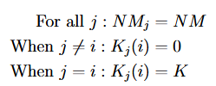
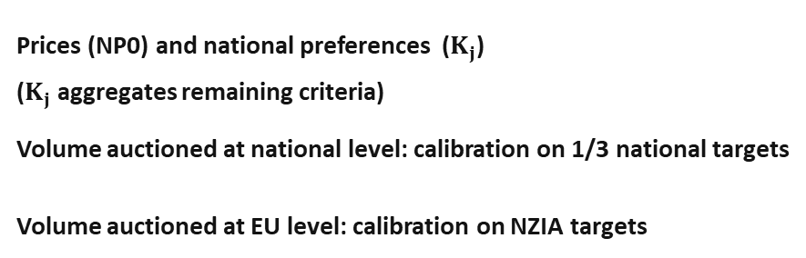
Case study
The case study investigates how heterogeneous implementation of non-price criteria influences market fragmentation risks and competition incentives in the European solar module manufacturing sector in 2030
Prices (NP0) and national preferences ($K_{j}$)
($K_{j}$ aggregates remaining criteria)
Volume auctioned at national level: calibration on 1/3 national targets
Volume auctioned at EU level: calibration on NZIA targets
We consider divergent implementations of non-price criteria
Price criteria homogeneous across country
Each country favours disjoint sets of modules
In numerical application, NM is kept constant, but K will increase to emulate increasingly divergent non price criteria

Slide 18
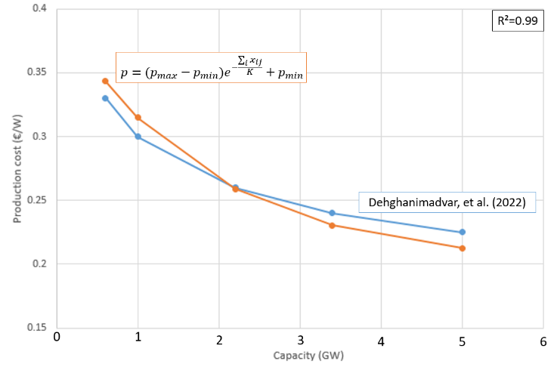

Case study – Module production cost and economies of scale
French demand in 2023
Production cost (€/W)
Capacity (GW)
Production cost estimation

Slide 19
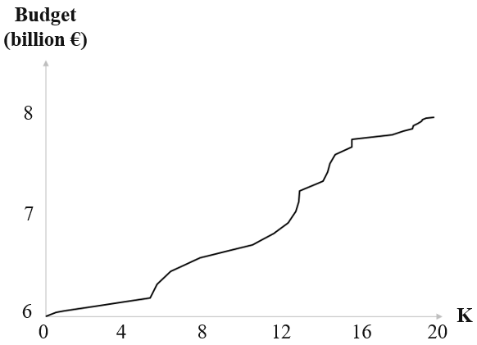
Case study – Results: Efficiency analysis
2 billion €

Slide 20
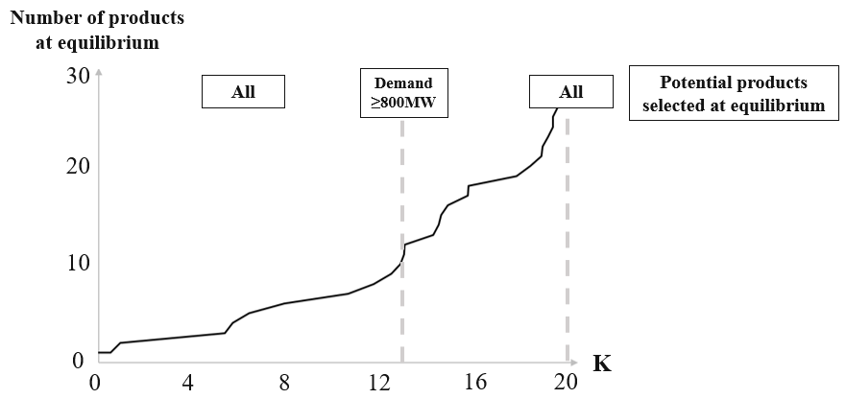
Case study – Results: Analysis of modules selected at equilibrium

Slide 21
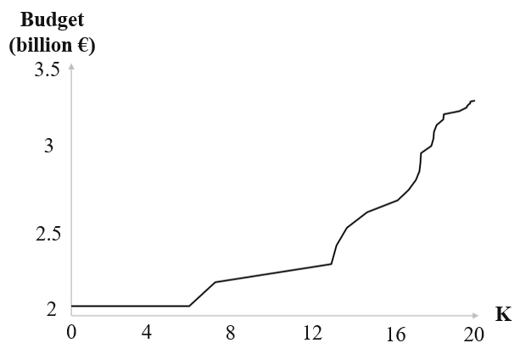
Case study – Results: Sensitivity analysis
In the sensitivity analysis, a target of 10 GW is considered for European solar PV manufacturing
Lower targets increase the marginal gains of economies of scale and make the cost of regulatory fragmentation higher in relative terms

Slide 22
Market fragmentation: Efficiency losses and fairness in European solar modules manufacturing
Introduction
Analytical framework
Case study
Conclusion

Slide 23
Conclusion
  Main findings
  Analytical results
  Environmental preferences do not necessarily conflict with economic efficiency.
  Non-price criteria can fragment the market or help solve the tension between competition and cost
  Numerical results
  Market fragmentation can generate substantial losses: 2 billion € per year
  Preferences divergence reduces competition and favours largest countries
  Policy recommendations
  A common framework to implement non-price criteria at the country level and reduce market fragmentation risks in the EU is a no regret strategy.

Slide 24
  Thank you for your attention

Slide 25
References
Boletín Oficial del Estado (2025): Orden TED/1444/2025, de 11 de diciembre, por la que se modifican las bases reguladoras de varios programas de ayudas, en el marco del Plan de Recuperación, Transformación y Resiliencia, financiado por la Unión Europea-Next Generation EU.
Colacicco, Rudy. 2024. ‘Strategic Trade Policy in General Oligopolistic Equilibrium: The Case of Import Tariffs’. Research in Economics 78 (2): 100959. https://doi.org/10.1016/j.rie.2024.100959.
Costa, Alberto, Tsan Sheng Ng, and Bin Su. 2023. ‘Long-Term Solar PV Planning: An Economic-Driven Robust Optimization Approach’. Applied Energy 335 (April):120702. https://doi.org/10.1016/j.apenergy.2023.120702.
CRE (2025): Cahier des charges de l’appel d’offres portant sur la réalisation et l’exploitation d’Installations de production d’électricité à partir de l’énergie solaire « Centrales sur bâtiments ou ombrières de puissance supérieure à 100 kWc et inférieure à 500 kWc ».
Dehghanimadvar, Mohammad, Renate Egan, and Nathan L. Chang. 2022. ‘Economic Assessment of Local Solar Module Assembly in a Global Market’. Cell Reports Physical Science 3 (2): 100747. https://doi.org/10.1016/j.xcrp.2022.100747.
‘Evenett, S., Jakubik, A., Martín, F. and Ruta, M. (2024). The Return of Industrial Policy in Data. IMF Working Paper No. 2024/001, Available at SSRN: Https://Ssrn.Com/Abstract=4697821 or Http://Dx.Doi.Org/10.5089/9798400261701.001’. n.d.
Helveston, John Paul, Gang He, and Michael R. Davidson. 2022. ‘Quantifying the Cost Savings of Global Solar Photovoltaic Supply Chains’. Nature 612 (7938): 83–87. https://doi.org/10.1038/s41586-022-05316-6.
IEA, Special Report on Solar PV Global Supply Chains, 2022
Irwin, Douglas. 2023. ‘The Return of Industrial Policy. Finance and Development. June 2023.
Journal Officiel de la République Française (2025): Arrêté du 8 septembre 2025 fixant les critères applicables à la livraison et à l’installation, dans les logements, des équipements de production d’électricité utilisant l’énergie radiative du soleil, d’une puissance installée inférieure ou égale à 9 kilowatts-crête, ouvrant droit à l’application du taux réduit de la taxe sur la valeur ajoutée mentionné à l’article 278-0 bis du code général des impôts
Kim, Ju-Hee, Seong-Jae Seo, and Seung-Hoon Yoo. 2021. ‘South Koreans’ Willingness to Pay Price Premium for Electricity Generated Using Domestic Solar Power Facilities over That from Imported Ones’. Solar Energy 224 (August):125–33. https://doi.org/10.1016/j.solener.2021.05.038.
Kulkarni, Ankur A. 2017. ‘Games and Teams with Shared Constraints’. Philosophical Transactions of the Royal Society A: Mathematical, Physical and Engineering Sciences 375 (2100): 20160302. https://doi.org/10.1098/rsta.2016.0302.
Kulkarni, Ankur A. 2019. ‘The Efficiency of Generalized Nash and Variational Equilibria’. arXiv. http://arxiv.org/abs/1908.00702.

Slide 26
References
Mansouri, Sayed Amin. 2022. ‘A Brief Review of the Evolution of International Trade Theories’. International Journal of Business and Development Studies 14 (2). https://doi.org/10.22111/ijbds.2022.7518.
MASE (2025): Decreto direttoriale del Ministero dell’ambiente e della sicurezza energetica 3 settembre 2025 n. 36 recante “Aggiornamento delle Regole operative del DM 30 dicembre 2024” c.d. FER X Transitorio
Mazzucato, Mariana, and Rainer Kattel. 2020. ‘Grand Challenges, Industrial Policy, and Public Value’. In The Oxford Handbook of Industrial Policy, by Mariana Mazzucato and Rainer Kattel, edited by Arkebe Oqubay, Christopher Cramer, Ha-Joon Chang, and Richard Kozul-Wright, 310–36. Oxford University Press. https://doi.org/10.1093/oxfordhb/9780198862420.013.12.
Münch, Florian Anselm, and Fabian Scheifele. 2023. ‘Nurturing National Champions? Local Content in Solar Auctions and Firm Innovation’. Energy Policy 179 (August):113574. https://doi.org/10.1016/j.enpol.2023.113574.
Orangi, Sina, and Anders Hammer Strømman. 2022. ‘A Techno-Economic Model for Benchmarking the Production Cost of Lithium-Ion Battery Cells’. Batteries 8 (8): 83.
PVXchange, https://www.pvxchange.com/Price-Index, 2024
Rentsch, Jochen, Sebastian Nold, Ralf Preu, Andreas W. Bett, W. Jooss, J. Trube, and P. Fath. 2019. ‘Competitiveness of a European PV Manufacturing Chain’.
RTE, Les Futurs Energétiques, 2021
Solar Power Europe, www.solarpowereurope.org, 2024
Veugelers, Reinhilde, Simone Tagliapietra, and Cecilia Trasi. 2024. ‘Green Industrial Policy in Europe: Past, Present, and Prospects’. Journal of Industry, Competition and Trade 24 (1): 4. https://doi.org/10.1007/s10842-024-00418-5.

